Slide 1
Data Mining:
Concepts and Techniques
— Chapter 1 —
— Introduction —
Jiawei Han and Micheline Kamber
Department of Computer Science
University of Illinois at Urbana-Champaign
www.cs.uiuc.edu/~hanj
©2006 Jiawei Han and Micheline Kamber. All rights reserved.
Data Mining: Concepts and Techniques

Slide 2
Introduction
Motivation: Why data mining?
What is data mining?
Data Mining: On what kind of data?
Data mining functionality
Classification of data mining systems
Top-10 most popular data mining algorithms
Major issues in data mining
Data Mining: Concepts and Techniques

Slide 3
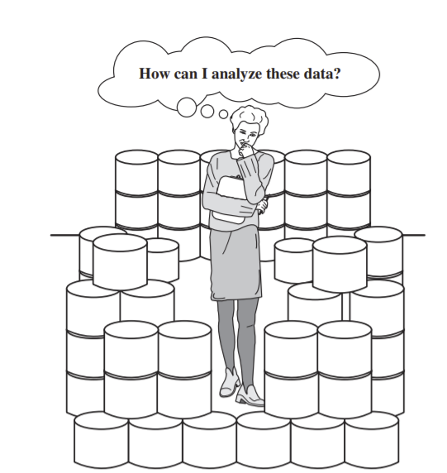
Why Data Mining?
The Explosive Growth of Data: from terabytes to petabytes
  Data collection and data availability
    Automated data collection tools, database systems, Web, computerized society
  Major sources of abundant data
    Business: Web, e-commerce, transactions, stocks, …
    Science: Remote sensing, bioinformatics, scientific simulation, …
    Society and everyone: news, digital cameras, YouTube
We are drowning in data, but starving for knowledge!
“Necessity is the mother of invention”—Data mining—Automated analysis of massive data sets
Data Mining: Concepts and Techniques

Slide 4
Evolution of Database Technology
1960s:
  Data collection, database creation, IMS and network DBMS
1970s:
  Relational data model, relational DBMS implementation
1980s:
  RDBMS, advanced data models (extended-relational, OO, deductive, etc.)
  Application-oriented DBMS (spatial, scientific, engineering, etc.)
1990s:
  Data mining, data warehousing, multimedia databases, and Web databases
2000s
  Stream data management and mining
  Data mining and its applications
  Web technology (XML, data integration) and global information systems
Data Mining: Concepts and Techniques

Slide 5
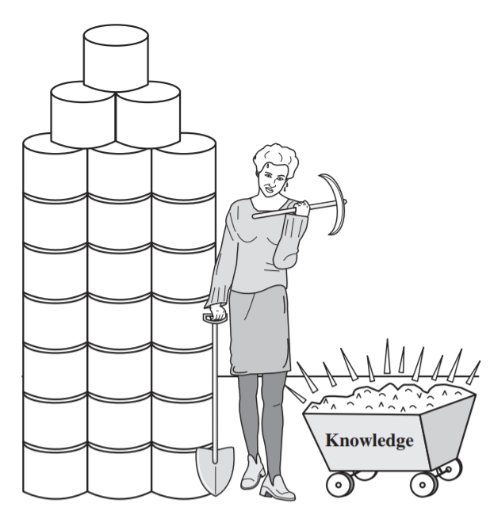

What Is Data Mining?
Data mining (knowledge discovery from data)
  Extraction of interesting (non-trivial, implicit, previously unknown and potentially useful) patterns or knowledge from huge amount of data
Alternative names
  Knowledge discovery (mining) in databases (KDD), knowledge extraction, data/pattern analysis, data archeology, data dredging, information harvesting, business intelligence, etc.
Data mining—searching for knowledge (interesting patterns) in data.
Data Mining: Concepts and Techniques

Slide 6
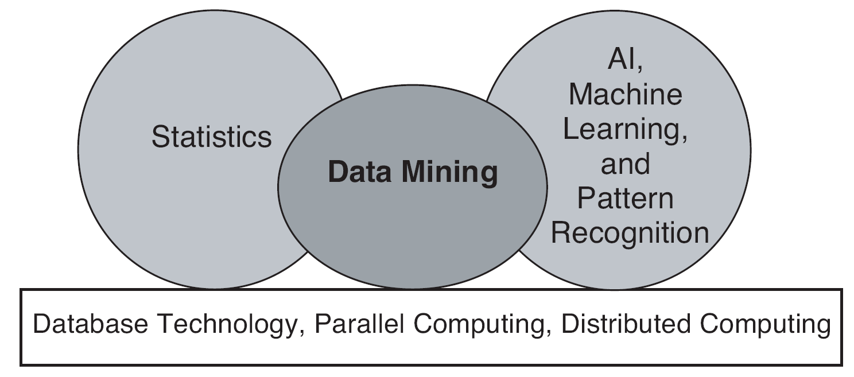
Origins of Data Mining
Draws ideas from machine learning/AI, pattern recognition, statistics, visualization and database systems
Traditional techniques may be unsuitable due to data that is
  Large-scale
  High dimensional
  Heterogeneous
  Complex
  Distributed
A key component of the emerging field of data science and data-driven discovery

Slide 7
Data Mining: Confluence of Multiple Disciplines
Database
Technology
Statistics
Machine
Learning
Data Mining
Visualization
Pattern
Recognition
Other
Disciplines
Algorithm
Data Mining: Concepts and Techniques

Slide 8
Data Mining: A KDD Process
Knowledge
  Data mining: the core of knowledge discovery process.
Pattern Evaluation
Data Mining
Task-relevant Data
Data Warehouse
Selection
Data Cleaning
Data Integration
Databases

Slide 9
KDD Process: A Typical View from ML and Statistics
Pattern
Information
Knowledge
Input Data
Data Pre-Processing
Data Mining
Post-Processing
Data integration
Normalization
Feature selection
Dimension reduction
Association Analysis
Classification
Clustering
Outlier analysis
Summary Generation
…
Pattern evaluation
Pattern selection
Pattern interpretation
Pattern visualization
This is a view from typical machine learning and statistics communities

Slide 10
KDD Process: Several Key Steps
Learning the application domain
  relevant prior knowledge and goals of application
Creating a target data set: data selection
Data cleaning and preprocessing: (may take 60% of effort!)
Data reduction and transformation
  Find useful features, dimensionality/variable reduction, invariant representation
Choosing functions of data mining
  summarization, classification, regression, association, clustering
Choosing the mining algorithm(s)
Data mining: search for patterns of interest
Pattern evaluation and knowledge presentation
  visualization, transformation, removing redundant patterns, etc.
Use of discovered knowledge
Data Mining: Concepts and Techniques

Slide 11
Data Mining and Business Intelligence
Increasing potential
to support
business decisions
End User
Decision Making
Data Presentation
Business
Analyst
Visualization Techniques
Data Mining
Data
Analyst
Information Discovery
Data Exploration
Statistical Summary, Querying, and Reporting
Data Preprocessing/Integration, Data Warehouses
Data Sources
DBA
Paper, Files, Web documents, Scientific experiments, Database Systems
Data Mining: Concepts and Techniques

Slide 12
Multi-Dimensional View of Data Mining
Data to be mined
  Relational, data warehouse, transactional, stream, object-oriented/relational, active, spatial, time-series, text, multi-media, heterogeneous, legacy, WWW
Knowledge to be mined
  Characterization, discrimination, association, classification, clustering, trend/deviation, outlier analysis, etc.
  Multiple/integrated functions and mining at multiple levels
Techniques utilized
  Database-oriented, data warehouse (OLAP), machine learning, statistics, visualization, etc.
Applications adapted
  Retail, telecommunication, banking, fraud analysis, bio-data mining, stock market analysis, text mining, Web mining, etc.
Data Mining: Concepts and Techniques

Slide 13
Data Mining: Classification Schemes
General functionality
  Descriptive data mining
  Predictive data mining
Different views lead to different classifications
  Data view: Kinds of data to be mined
  Knowledge view: Kinds of knowledge to be discovered
  Method view: Kinds of techniques utilized
  Application view: Kinds of applications adapted
Data Mining: Concepts and Techniques

Slide 14
Data Mining: On What Kinds of Data?
Database-oriented data sets and applications
  Relational database, data warehouse, transactional database
Advanced data sets and advanced applications
  Data streams and sensor data
  Time-series data, temporal data, sequence data (incl. bio-sequences)
  Structure data, graphs, social networks and multi-linked data
  Object-relational databases
  Heterogeneous databases and legacy databases
  Spatial data and spatiotemporal data
  Multimedia database
  Text databases
  The World-Wide Web
Data Mining: Concepts and Techniques

Slide 15
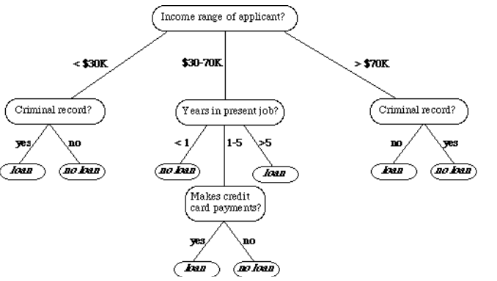
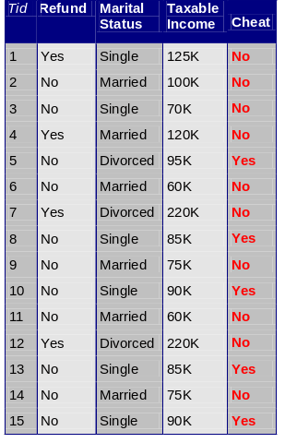



Data Mining Tasks …
Data
Clustering
Predictive Modeling
Association
Analysis
Anomaly
Detection
Summarization
Milk

Slide 16
Data Mining Tasks
Prediction Methods
  Use some variables to predict unknown or future values of other variables.
Description Methods
  Find human-interpretable patterns that describe the data; create summaries

Slide 17
Data Mining Tasks...
Classification [Predictive]
Clustering [Descriptive]
Association Rule Discovery [Descriptive]
Sequential Pattern Discovery [Descriptive]
Regression [Predictive]
Deviation Detection / Anomaly Detection [Predictive]

Slide 18
Data Mining Functions: (1) Generalization
Materials to be covered in Chapters 2-4
Information integration and data warehouse construction
  Data cleaning, transformation, integration, and multidimensional data model
Data cube technology
  Scalable methods for computing (i.e., materializing) multidimensional aggregates
  OLAP (online analytical processing)
Multidimensional concept description: Characterization and discrimination
  Generalize, summarize, and contrast data characteristics, e.g., dry vs. wet regions
Data Mining: Concepts and Techniques

Slide 19
Data Mining Functions: (2) Association and Correlation Analysis (Chapter 5)
Frequent patterns (or frequent itemsets)
  What items are frequently purchased together in your Walmart?
Association, correlation vs. causality
  A typical association rule
    Diaper → Beer [0.5%, 75%] (support, confidence)
  Are strongly associated items also strongly correlated?
How to mine such patterns and rules efficiently in large datasets?
How to use such patterns for classification, clustering, and other applications?
Data Mining: Concepts and Techniques

Slide 20

Association Rule Discovery: Definition
Given a set of records each of which contain some number of items from a given collection;
  Produce dependency rules which will predict occurrence of an item based on occurrences of other items.
Rules Discovered:
{Milk} --> {Coke}
{Diaper, Milk} --> {Beer}

Slide 21
Data Mining Functions: (3) Classification and Prediction (Chapter 6)
Classification and prediction
  Construct models (functions) based on some training examples
  Describe and distinguish classes or concepts for future prediction
    E.g., classify countries based on (climate), or classify cars based on (gas mileage)
  Predict some unknown or missing numerical values
Typical methods
  Decision trees, naïve Bayesian classification, support vector machines, neural networks, rule-based classification, pattern-based classification, logistic regression, …
Typical applications:
  Credit card fraud detection, direct marketing, classifying stars, diseases, web-pages, …
Data Mining: Concepts and Techniques

Slide 22


Classification Example
categorical
categorical
continuous
class
Test
Set
Learn
Classifier
Training
Set
Model

Slide 23
Data Mining Functions: (4) Cluster and Outlier Analysis (Chapter 7)
Cluster analysis
  Unsupervised learning (i.e., Class label is unknown)
  Group data to form new categories (i.e., clusters), e.g., cluster houses to find distribution patterns
  Principle: Maximizing intra-class similarity & minimizing interclass similarity
  Many methods and applications
Outlier analysis
  Outlier: A data object that does not comply with the general behavior of the data
  Noise or exception? ― One person’s garbage could be another person’s treasure
  Methods: by product of clustering or regression analysis, …
  Useful in fraud detection, rare events analysis
Data Mining: Concepts and Techniques

Slide 24
Illustrating Clustering
Euclidean Distance Based Clustering in 3-D space.
Intracluster distances
are minimized
Intercluster distances
are maximized

Slide 25
Data Mining Functions: (5) Trend and Evolution Analysis (Chapter 8)
Sequence, trend and evolution analysis
  Trend and deviation analysis: e.g., regression
  Sequential pattern mining
    e.g., first buy digital camera, then large SD memory cards
  Periodicity analysis
  Motifs, time-series, and biological sequence analysis
    Approximate and consecutive motifs
  Similarity-based analysis
Mining data streams
  Ordered, time-varying, potentially infinite, data streams
Data Mining: Concepts and Techniques

Slide 26
Data Mining Functions: (6) Structure and Network Analysis (Chapter 9)
Graph mining
  Finding frequent subgraphs (e.g., chemical compounds), trees (XML), substructures (web fragments)
Information network analysis
  Social networks: actors (objects, nodes) and relationships (edges)
    e.g., author networks in CS, terrorist networks
  Multiple heterogeneous networks
    A person could be multiple information networks: friends, family, classmates, …
  Links carry a lot of semantic information: Link mining
Web mining
  Web is a big information network: from PageRank to Google
  Analysis of Web information networks
    Web community discovery, opinion mining, usage mining, …
Data Mining: Concepts and Techniques

Slide 27
Top-10 Most Popular DM Algorithms:
18 Identified Candidates (I)
Classification
  #1. C4.5: Quinlan, J. R. C4.5: Programs for Machine Learning. Morgan Kaufmann., 1993.
  #2. CART: L. Breiman, J. Friedman, R. Olshen, and C. Stone. Classification and Regression Trees. Wadsworth, 1984.
  #3. K Nearest Neighbours (kNN): Hastie, T. and Tibshirani, R. 1996. Discriminant Adaptive Nearest Neighbor Classification. TPAMI. 18(6)
  #4. Naive Bayes Hand, D.J., Yu, K., 2001. Idiot's Bayes: Not So Stupid After All? Internat. Statist. Rev. 69, 385-398.
Statistical Learning
  #5. SVM: Vapnik, V. N. 1995. The Nature of Statistical Learning Theory. Springer-Verlag.
  #6. EM: McLachlan, G. and Peel, D. (2000). Finite Mixture Models. J. Wiley, New York. Association Analysis
  #7. Apriori: Rakesh Agrawal and Ramakrishnan Srikant. Fast Algorithms for Mining Association Rules. In VLDB '94.
  #8. FP-Tree: Han, J., Pei, J., and Yin, Y. 2000. Mining frequent patterns without candidate generation. In SIGMOD '00.
Data Mining: Concepts and Techniques

Slide 28
The 18 Identified Candidates (II)
Link Mining
  #9. PageRank: Brin, S. and Page, L. 1998. The anatomy of a large-scale hypertextual Web search engine. In WWW-7, 1998.
  #10. HITS: Kleinberg, J. M. 1998. Authoritative sources in a hyperlinked environment. SODA, 1998.
Clustering
  #11. K-Means: MacQueen, J. B., Some methods for classification and analysis of multivariate observations, in Proc. 5th Berkeley Symp. Mathematical Statistics and Probability, 1967.
  #12. BIRCH: Zhang, T., Ramakrishnan, R., and Livny, M. 1996. BIRCH: an efficient data clustering method for very large databases. In SIGMOD '96.
Bagging and Boosting
  #13. AdaBoost: Freund, Y. and Schapire, R. E. 1997. A decision-theoretic generalization of on-line learning and an application to boosting. J. Comput. Syst. Sci. 55, 1 (Aug. 1997), 119-139.
Data Mining: Concepts and Techniques

Slide 29
The 18 Identified Candidates (III)
Sequential Patterns
  #14. GSP: Srikant, R. and Agrawal, R. 1996. Mining Sequential Patterns: Generalizations and Performance Improvements. In Proceedings of the 5th International Conference on Extending Database Technology, 1996.
  #15. PrefixSpan: J. Pei, J. Han, B. Mortazavi-Asl, H. Pinto, Q. Chen, U. Dayal and M-C. Hsu. PrefixSpan: Mining Sequential Patterns Efficiently by Prefix-Projected Pattern Growth. In ICDE '01.
Integrated Mining
  #16. CBA: Liu, B., Hsu, W. and Ma, Y. M. Integrating classification and association rule mining. KDD-98.
Rough Sets
  #17. Finding reduct: Zdzislaw Pawlak, Rough Sets: Theoretical Aspects of Reasoning about Data, Kluwer Academic Publishers, Norwell, MA, 1992
Graph Mining
  #18. gSpan: Yan, X. and Han, J. 2002. gSpan: Graph-Based Substructure Pattern Mining. In ICDM '02.
Data Mining: Concepts and Techniques

Slide 30
Top-10 Algorithm Finally Selected at ICDM’06
#1: C4.5 (61 votes)
#2: K-Means (60 votes)
#3: SVM (58 votes)
#4: Apriori (52 votes)
#5: EM (48 votes)
#6: PageRank (46 votes)
#7: AdaBoost (45 votes)
#7: kNN (45 votes)
#7: Naive Bayes (45 votes)
#10: CART (34 votes)
Data Mining: Concepts and Techniques

Slide 31
Are All the “Discovered” Patterns Interesting?
Data mining may generate thousands of patterns: Not all of them are interesting
  Suggested approach: Human-centered, query-based, focused mining
Interestingness measures
  A pattern is interesting if it is easily understood by humans, valid on new or test data with some degree of certainty, potentially useful, novel, or validates some hypothesis that a user seeks to confirm
Objective vs. subjective interestingness measures
  Objective: based on statistics and structures of patterns, e.g., support, confidence, etc.
  Subjective: based on user’s belief in the data, e.g., unexpectedness, novelty, actionability, etc.
Data Mining: Concepts and Techniques

Slide 32
Find All and Only Interesting Patterns?
Find all the interesting patterns: Completeness
  Can a data mining system find all the interesting patterns? Do we need to find all of the interesting patterns?
  Heuristic vs. exhaustive search
  Association vs. classification vs. clustering
Search for only interesting patterns: An optimization problem
  Can a data mining system find only the interesting patterns?
  Approaches
    First general all the patterns and then filter out the uninteresting ones
    Generate only the interesting patterns—mining query optimization
Data Mining: Concepts and Techniques

Slide 33
Other Pattern Mining Issues
Precise patterns vs. approximate patterns
  Association and correlation mining: possible find sets of precise patterns
    But approximate patterns can be more compact and sufficient
    How to find high quality approximate patterns??
  Gene sequence mining: approximate patterns are inherent
    How to derive efficient approximate pattern mining algorithms??
Constrained vs. non-constrained patterns
  Why constraint-based mining?
  What are the possible kinds of constraints? How to push constraints into the mining process?
Data Mining: Concepts and Techniques

Slide 34
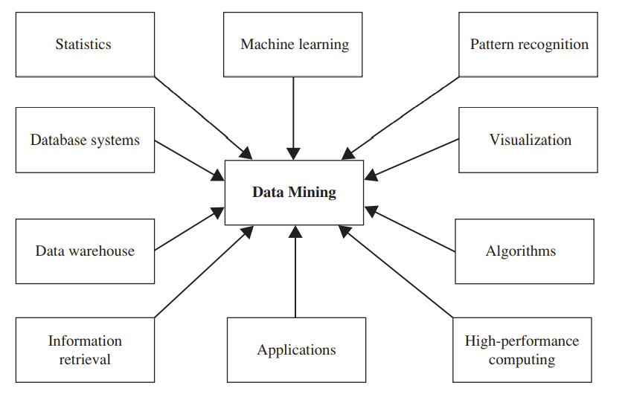
Which Technologies Are Used?
Data mining adopts techniques from many domains.
Data Mining: Concepts and Techniques

Slide 35
Integration of Data Mining and Data Warehousing
Data mining systems, DBMS, Data warehouse systems coupling
  No coupling, loose-coupling, semi-tight-coupling, tight-coupling
On-line analytical mining data
  integration of mining and OLAP technologies
Interactive mining multi-level knowledge
  Necessity of mining knowledge and patterns at different levels of abstraction by drilling/rolling, pivoting, slicing/dicing, etc.
Integration of multiple mining functions
  Characterized classification, first clustering and then association
Data Mining: Concepts and Techniques

Slide 36
Coupling Data Mining with DB/DW Systems
No coupling—flat file processing, not recommended
Loose coupling
  Fetching data from DB/DW
Semi-tight coupling—enhanced DM performance
  Provide efficient implement a few data mining primitives in a DB/DW system, e.g., sorting, indexing, aggregation, histogram analysis, multiway join, precomputation of some stat functions
Tight coupling—A uniform information processing environment
  DM is smoothly integrated into a DB/DW system, mining query is optimized based on mining query, indexing, query processing methods, etc.
Data Mining: Concepts and Techniques

Slide 37
Architecture: Typical Data Mining System
Graphical User Interface
Pattern Evaluation
Knowledge-Base
Data Mining Engine
Database or Data Warehouse Server
data cleaning, integration, and selection
Data
Warehouse
World-Wide
Web
Other Info
Repositories
Database
Data Mining: Concepts and Techniques

Slide 38
An OLAM Architecture
Mining query
Mining result
Layer4
User Interface
User GUI API
OLAM
Engine
OLAP
Engine
Layer3
OLAP/OLAM
Data Cube API
Multidimensional database
Layer2
MDDB
MDDB
Meta Data
Filtering&Integration
Database API
Filtering
Layer1
Data Repository
Data cleaning
Data
Warehouse
Databases
Data integration

Slide 39
Major Issues in Data Mining
Mining methodology
  Mining different kinds of knowledge from diverse data types, e.g., bio, stream, Web
  Performance: efficiency, effectiveness, and scalability
  Pattern evaluation: the interestingness problem
  Incorporation of background knowledge
  Handling noise and incomplete data
  Parallel, distributed and incremental mining methods
  Integration of the discovered knowledge with existing one: knowledge fusion
User interaction
  Data mining query languages and ad-hoc mining
  Expression and visualization of data mining results
  Interactive mining of knowledge at multiple levels of abstraction
Applications and social impacts
  Domain-specific data mining & invisible data mining
  Protection of data security, integrity, and privacy
Data Mining: Concepts and Techniques

Slide 40
Why Data Mining?—Potential Applications
Data analysis and decision support
  Market analysis and management
    Target marketing, customer relationship management (CRM), market basket analysis, cross selling, market segmentation
  Risk analysis and management
    Forecasting, customer retention, improved underwriting, quality control, competitive analysis
  Fraud detection and detection of unusual patterns (outliers)
Other Applications
  Text mining (news group, email, documents) and Web mining
  Stream data mining
  Bioinformatics and bio-data analysis
Data Mining: Concepts and Techniques

Slide 41
Ex. 1: Market Analysis and Management
Where does the data come from?—Credit card transactions, loyalty cards, discount coupons, customer complaint calls, plus (public) lifestyle studies
Target marketing
  Find clusters of “model” customers who share the same characteristics: interest, income level, spending habits, etc.
  Determine customer purchasing patterns over time
Cross-market analysis—Find associations/co-relations between product sales, & predict based on such association
Customer profiling—What types of customers buy what products (clustering or classification)
Customer requirement analysis
  Identify the best products for different groups of customers
  Predict what factors will attract new customers
Provision of summary information
  Multidimensional summary reports
  Statistical summary information (data central tendency and variation)
Data Mining: Concepts and Techniques

Slide 42
Ex. 2: Corporate Analysis & Risk Management
Finance planning and asset evaluation
  cash flow analysis and prediction
  contingent claim analysis to evaluate assets
  cross-sectional and time series analysis (financial-ratio, trend analysis, etc.)
Resource planning
  summarize and compare the resources and spending
Competition
  monitor competitors and market directions
  group customers into classes and a class-based pricing procedure
  set pricing strategy in a highly competitive market
Data Mining: Concepts and Techniques

Slide 43
Ex. 3: Fraud Detection & Mining Unusual Patterns
Approaches: Clustering & model construction for frauds, outlier analysis
Applications: Health care, retail, credit card service, telecomm.
  Auto insurance: ring of collisions
  Money laundering: suspicious monetary transactions
  Medical insurance
    Professional patients, ring of doctors, and ring of references
    Unnecessary or correlated screening tests
  Telecommunications: phone-call fraud
    Phone call model: destination of the call, duration, time of day or week. Analyze patterns that deviate from an expected norm
  Retail industry
    Analysts estimate that 38% of retail shrink is due to dishonest employees
  Anti-terrorism
Data Mining: Concepts and Techniques

Slide 44
Summary
Data mining: Discovering interesting patterns from large amounts of data
A natural evolution of database technology, in great demand, with wide applications
A KDD process includes data cleaning, data integration, data selection, transformation, data mining, pattern evaluation, and knowledge presentation
Mining can be performed in a variety of information repositories
Data mining functionalities: characterization, discrimination, association, classification, clustering, outlier and trend analysis, etc.
Data mining systems and architectures
Major issues in data mining
Data Mining: Concepts and Techniques

